Slide 1

BASIC ELECTRICAL AND ELECTRONICS ENGINEERING
Course Code: CSE1002
SCHOOL OF COMPUTER SCIENCE ENGINEERING AND APPLICATIONS
Mrunmayee Rahate
Assistant Professor, DYPIU

Slide 2
Module 1: Fundamentals of Electrical Circuits
Lecture 1: Introduction to the Electrical Engineering Concepts

Slide 3
What is Electrical Engineering?
Energy
Information
Generation
Transmission
Distribution
Utilization
Low Amplitude V, I
Communication
Devices & Circuits
Notes:
What is Electrical Engineering?
Electrical Engineering is the discipline focused on the study, design, development, and application of electrical systems, devices, and technologies using electricity, electronics, and electromagnetism to meet diverse needs, ranging from power generation and distribution to electronics, telecommunications, and computing.
According to the diagram, it is divided into two main areas:
1. Energy (Power Systems)
This side of Electrical Engineering focuses on generating, transmitting, distributing, and utilizing electrical energy. It deals mainly with high-power electrical systems, which power our homes, industries, and cities.
a. Generation
This is where electrical energy is produced.
It involves power plants that convert other forms of energy (like coal, natural gas, nuclear, hydro, solar, or wind) into electrical energy.
Electrical engineers design and maintain generators and systems that produce electrical power efficiently.
b. Transmission
After electricity is generated, it needs to be transported over long distances to reach consumers.
Transmission systems use high-voltage power lines to reduce losses while transporting electricity across regions.
Electrical engineers work on designing transmission lines, transformers, and substations to ensure reliable and efficient transport of power.
c. Distribution
Once electricity reaches the vicinity of the consumers, it is stepped down to safer voltages and distributed locally.
Distribution networks include poles, transformers, and wiring that deliver electricity to homes, businesses, and factories.
Engineers optimize distribution systems to ensure safety, reliability, and efficiency.
d. Utilization
This is the final stage where electrical energy is used by consumers.
Electrical engineering focuses on the design of electrical appliances, lighting, motors, heating devices, and industrial machines.
Understanding how electrical energy is utilized helps improve energy efficiency and performance.
2. Information (Electronics and Communication)
This side of Electrical Engineering deals with the processing and transmission of information using electrical signals, usually at much lower voltages and currents compared to power systems.
a. Low Amplitude Voltage and Current (V, I)
Signals in communication and electronics are typically low power — low voltage and current.
These signals carry information (like audio, video, or data) and require amplification and processing.
Electrical engineers design circuits and devices that handle these weak signals without distortion or loss.
b. Communication
This involves the transmission and reception of information over distances, including radio, television, telephone, internet, and satellite systems.
Electrical engineers develop communication protocols, antennas, transmitters, and receivers.
This field also includes wireless communication, fiber optics, networking, and data transmission technologies.
c. Devices & Circuits
This covers the design and application of electronic components such as transistors, diodes, microprocessors, and integrated circuits.
These devices process electrical signals to perform tasks such as computation, control, signal amplification, and digital data handling.
Electrical engineers design circuits that form the backbone of computers, smartphones, medical devices, and more.
Summary
Electrical Engineering is the field that manages both Energy and Information through electrical and electronic technologies.
The Energy side focuses on large-scale power systems: generating electricity, transmitting it over distances, distributing it safely, and ensuring effective use.
The Information side focuses on low-power signals and systems that communicate, process, and control information via electronic devices and circuits.

Slide 4
DEVICE
Building Block of the Circuit
Ex: Transistor, Resistor, Inductor, Capacitor, etc.
CIRCUIT
Meaningful Interconnection of Devices to Perform a Specific Function
SYSTEM
Circuit + Device (Electrical/ Non Electrical Interface)
Ex: Low-pass Filter, Power Supply Circuit, etc.
Ex: Communication System, Robotic Arm, etc.
Notes:
1. DEVICE A Device is the most fundamental building block in an electrical circuit.
These are individual components that have specific electrical characteristics.
Devices can be active (e.g., transistor) or passive (e.g., resistor, capacitor, inductor).
Examples:
Resistor – limits current
Capacitor – stores electrical energy in an electric field
Inductor – stores energy in a magnetic field
Transistor – amplifies or switches electronic signals
Devices alone don't do much — they need to be connected meaningfully to create functionality.
2. CIRCUIT A Circuit is a meaningful interconnection of devices designed to perform a specific electrical function.
A circuit is more than just a collection of devices; it has a purpose.
It can be analog or digital, simple or complex.
Examples:
A low-pass filter made of a resistor and capacitor.
An amplifier made using transistors and resistors.
A power supply circuit that regulates voltage.
3. SYSTEM A System is a higher-level structure that combines multiple circuits and devices — possibly including both electrical and non-electrical components — to perform a complete and complex function.
Systems can include sensors, actuators, software, user interfaces, etc.
Focus is on overall behavior, input/output functionality, and interaction with the environment.
Examples:
A robotic arm – combines motors (electromechanical devices), control circuits, sensors, and software.
A communication system – consists of transmitters, receivers, antennas, signal processors.
A mobile phone – integrates power management, signal processing, RF communication, user interface, etc.
Systems = Circuits + Devices + Interfaces (may include software, mechanical parts, etc.

Slide 5
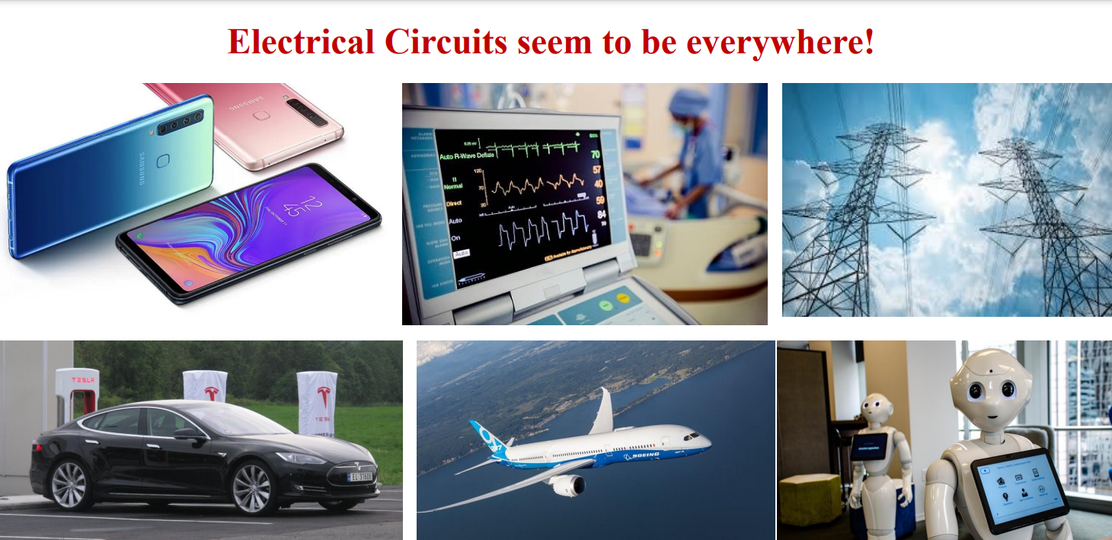
Notes:
"Electrical Circuits seem to be everywhere!“ — electrical circuits are embedded in nearly every aspect of modern life.
1. Smartphones
Smartphones are complex electronic systems made up of countless electrical circuits and devices:
Circuits in action: Signal processing, power management, memory, and display control.
Devices used: Microprocessors, sensors, amplifiers, antennas, and batteries.
Functionality enabled by circuits: Touchscreen interaction, wireless communication (Wi-Fi, 4G/5G), cameras, and GPS.
2. Medical Equipment
Modern healthcare depends heavily on electronic circuits:
Circuits in action: Monitoring vital signs like ECG, EEG, oxygen levels, and more.
Devices used: Bio-sensors, amplifiers, analog-to-digital converters.
Functionality enabled: Real-time monitoring, diagnostics, and life-support systems.
3. Power Transmission
This relates to the energy aspect of electrical engineering:
Circuits in action: High-voltage power transmission lines and control systems.
Devices used: Transformers, circuit breakers, relays, and SCADA systems.
Functionality enabled: Efficient delivery of electricity from generation plants to homes and industries.
4. Electric Vehicles
Electric cars are electronics on wheels:
Circuits in action: Battery management, motor control, power conversion, autonomous driving.
Devices used: Power MOSFETs/IGBTs, sensors, microcontrollers.
Functionality enabled: Energy-efficient transport, regenerative braking, infotainment, ADAS.
5. Aircraft
Modern airplanes are flying examples of advanced electrical engineering:
Circuits in action: Navigation, communication, fly-by-wire control systems.
Devices used: Inertial measurement units, radar systems, GPS, actuators.
Functionality enabled: Precise flight control, communication, safety systems.
6. Robots
Robots are physical systems controlled by circuits and code:
Circuits in action: Motion control, sensor input processing, AI decision-making.
Devices used: Motors, microcontrollers, cameras, servos, touch sensors.
Functionality enabled: Interaction, movement, speech, facial recognition.

Slide 6
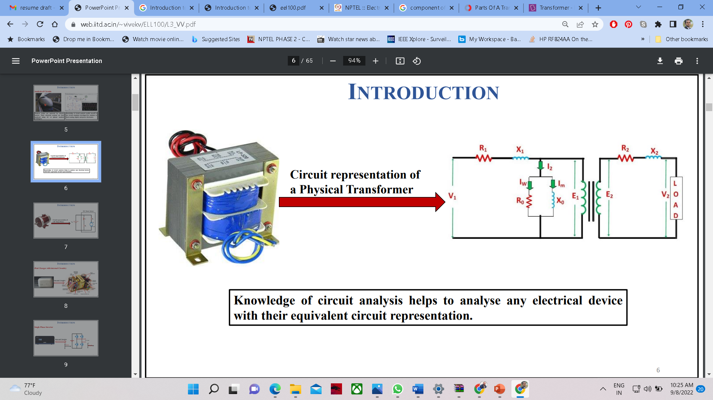
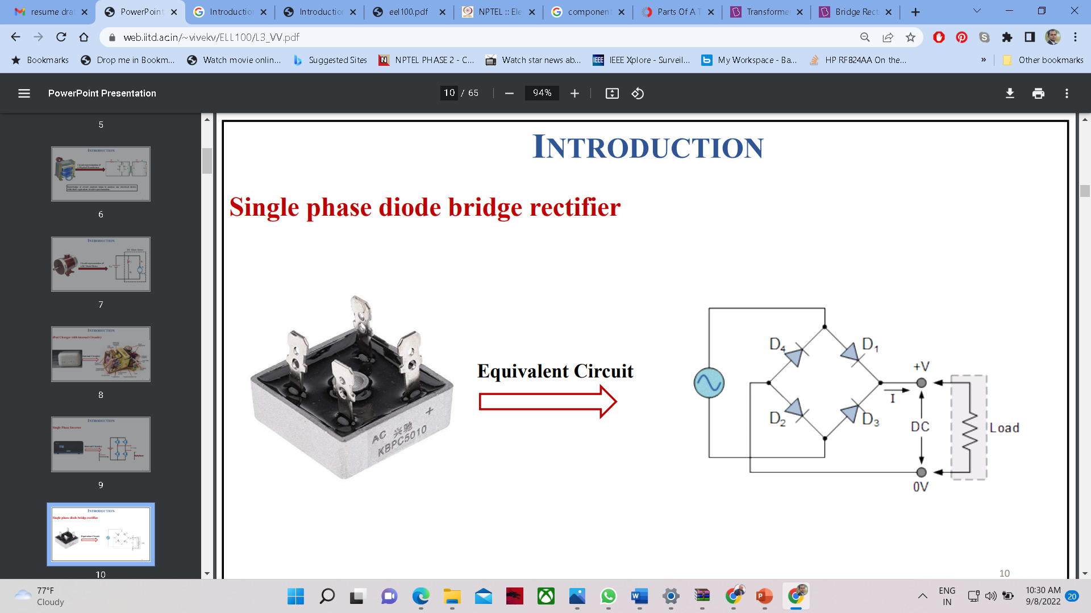
CIRCUIT MODEL
Transformer
Bridge Rectifier
Knowledge of circuit analysis helps to analyze any electrical device with their equivalent circuit representation.
Notes:
A circuit model is a simplified electrical representation of a physical device or system using ideal components like:
Resistors (R)
Inductors (L or X)
Capacitors (C)
Voltage or current sources
Diodes, etc.
Circuit models help engineers analyze and predict how a device will behave in an electrical network.
Transformer and Its Circuit Representation
Real Component: Transformer
A transformer is used to step up or step down voltage in AC systems.
It works on the principle of electromagnetic induction between two coils (primary and secondary).
Circuit Representation:
The equivalent circuit of a transformer includes:
Primary side components:
R1: Primary winding resistance
X1: Primary leakage reactance
R0: Core loss resistance
X0: Magnetizing reactance
Secondary side components:
R2: Secondary winding resistance
X2: Secondary leakage reactance
Load resistance connected across V2
Why this model is useful:
It enables accurate analysis of voltage regulation, losses, efficiency, and behavior under different load conditions — without physically testing the transformer in all possible cases.
Bridge Rectifier and Its Equivalent Circuit
Real Component: Bridge Rectifier
Converts AC (Alternating Current) into DC (Direct Current).
Uses 4 diodes arranged in a bridge configuration.
Equivalent Circuit:
Shows 4 diodes (D1, D2, D3, D4) arranged in a bridge.
Converts sinusoidal AC input into pulsating DC.
Output is connected to a load (resistor).
Why this model is useful:
Helps in understanding the rectification process, calculating:
Peak Output Voltage
Ripple
Current flow through each diode
Essential for designing power supply units

Slide 7
Force
Energy
Charge
Current
Potential
$$\vec{f}=m\vec{a}$$
𝒇 ⃗=𝒎𝒂 ⃗
Unit: Newton
Rate of Doing Work
Power
Capacity of Doing Work
$$e=1.602 ∗{10}^{−19} C$$
𝒆=𝟏.𝟔𝟎𝟐 ∗〖𝟏𝟎〗^(−𝟏𝟗) 𝑪
$$\vec{f}=q\vec{E}$$
𝒇 ⃗=𝒒𝑬 ⃗
Rate of Flow of Charge
Unit: Ampere
$$I=\frac{dq}{dt}$$
𝑰=𝒅𝒒/𝒅𝒕
Work Done Per Unit Charge to Move a Charge Between Two Points
Unit: Joules
Unit: Joules/ Sec
Always Measured Relative to Another Point
Unit: Volt
Basics
Notes:
1. Force Force is the product of mass (m) and acceleration (a).
Unit: Newton (N)
2. Energy
The capacity to do work.
Unit: Joule (J) In electrical systems, energy appears as stored energy in capacitors, batteries, or magnetic fields in inductors.
3. Power
The rate at which work is done or energy is transferred.
Unit: Joule/second (J/s), which is also called a Watt (W)
4. Charge
Elementary charge: $e=1.602 ∗{10}^{−19} C$
This is the charge of a single electron or proton.
Electric Force: A charge q experiences a force f in an electric field E.
Charge is a fundamental property in all electrical phenomena.
5. Current
Rate of flow of electric charge. Unit: Ampere (A) 1 A=1 Coulomb/ 1 Second
6. Potential (Voltage)
Potential (also known as voltage) is the work done per unit charge to move a charge between two points.
Voltage is always measured relative to another point (i.e., it's a difference in potential).
It is the "electrical pressure" that pushes current through a circuit.
Units: Volt (V) = Joule/ Coulomb

Slide 8

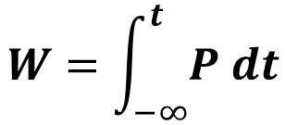

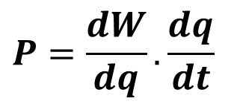
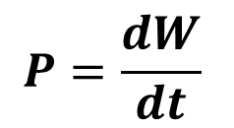

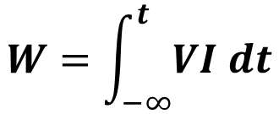
Charge
Voltage
Energy
$$dW=V.dq$$
$$V=\frac{dW}{dq}$$
$$P=\frac{dW}{dt}$$
$$W=\int_{−∞}^{t}{P dt}$$
$$P=\frac{dW}{dq}. \frac{dq}{dt}$$
$$W=\int_{−∞}^{t}{VI dt}$$
$$P=V.I$$
Notes:
The Relationship Between Charge, Voltage, and Energy
Energy (Work) is transferred when Charge flows through a potential difference (Voltage).
dW=V ⋅ dq
This is the infinitesimal amount of work (energy) done when a small amount of charge dq moves across a potential difference V.
This is a core equation in electrostatics and circuit theory.
Work = Voltage × Charge
2. V=dW/ dq
Rearranging the first equation gives the definition of Voltage.
Voltage is the work done per unit charge.
3. P=dW/ dt
This defines Power (P) as the rate at which work is done (energy is used or transferred) over time.
Unit of Power is Watt (W).
4. P=dW/ dq ⋅ dq/ dt
Applying the chain rule from calculus:
dW/ dt=dW/ dq ⋅ dq/ dt
5. P=V ⋅ I
Substituting into the previous expression, we get the basic electrical power formula:
Power = Voltage × Current

Slide 9
Thank You !!!

